Slide 1
Predicting the severity of accidents

Slide 2
Introduction
1.35 million people die because of road traffic accident.
20-50 million people suffer non-fatal injuries.
Road traffic accident as leading cause for death in U.S.A.
Prediction system that can tell driver the probability of getting into accident and of what severity.
Helpful for drivers, polices, emergency teams, policy makers, road design, insurance companies.

Slide 3
Data
Vehicle collision data of Seattle from 2004-2020.
Provided by SPD and recorded by traffic records.
38 total features.
Unbalanced data.

Slide 4
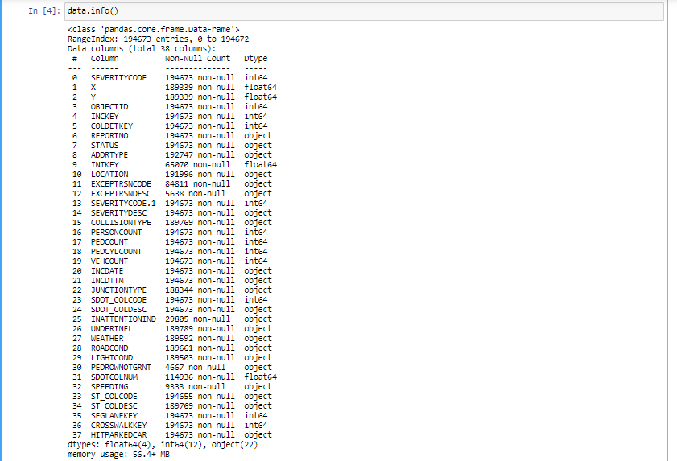

Slide 5
Methodology
After removing unnecessary features 8 features left excluding SEVERITYCODE.
Remaining features have missing values which needed to be filled.
Custom transformer created to fill missing values.
Another custom transformer created for converting non-numeric categorical features.
Unbalanced data were balanced using downsizing strategy.
Random forest classifier was uses as the model.
Data were split into training and testing data.

Slide 6
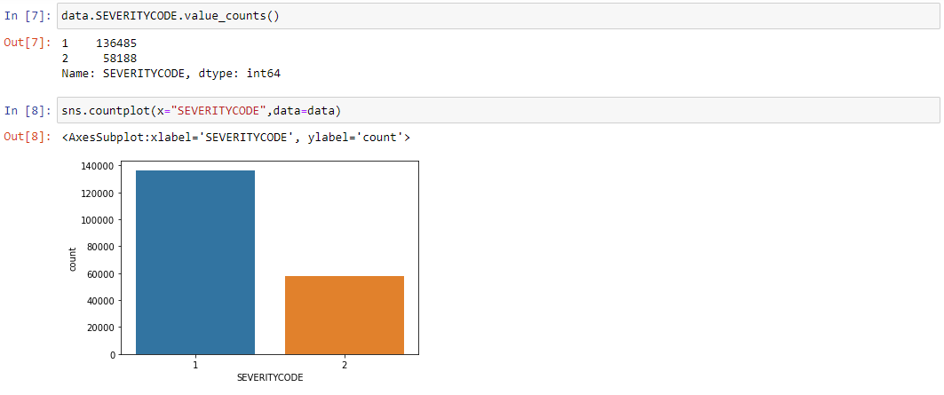
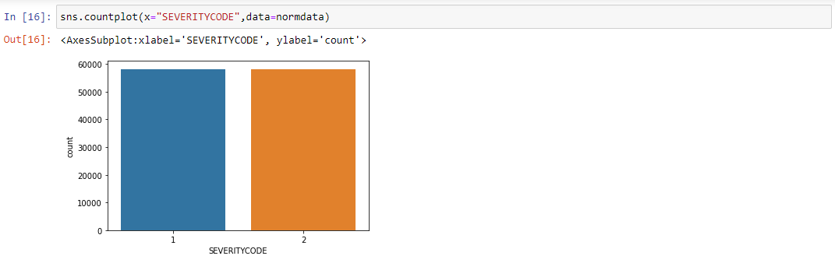
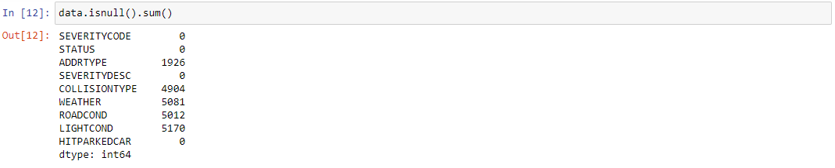
Fig: unbalanced data
Fig: balanced data after downsizing Fig: null values of remaining features

Slide 7
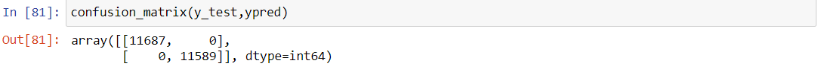
Result
Training and testing score of 1 obtained.
Fig: confusion matrix showing true and predicted values.

Slide 8
Discussion
Score of 1 during training could be due to overfitting, but it also gave a score of 1 for unseen data sets.
Severity code 1 and 2 accident mostly occurs in daylight condition.
Severity code 1 and 2 accident mostly occurs in dry road.
Severity code 1 and 2 accident mostly occurs in clear weather.

Slide 9
Conclusion
Data were pre-processed.
Data were balanced using downsizing strategy.
Data were split into training and testing data.
Random forest classifier was used as a model.
Gave training and testing score of 1.

